Slide 1
Dormant Assets Expansion
Investment Association
19th April 2022
Adrian Smith OBE, Chief Executive, Reclaim Fund Limited
adrian.smith@reclaimfund.co.uk
For more information: dormantassets@reclaimfund.co.uk

Slide 2
What is the Dormant Assets Scheme?
Dormant Assets are accounts, funds, policies or shares that have not been accessed for 15 years* or more, and that cannot be reunited with their holders.
Since 2011, banks and building societies have been able to participate in the voluntary Dormant Assets Scheme, operated by Reclaim Fund Ltd (RFL). There are now 35 members, including all of the major high street banks.
Assets that cannot be reunited with their owners can be transferred to RFL. RFL guarantees future reclaims, and transfers surplus funds** to social and community initiatives via the National Lottery Community Fund.
By the end of 2021, RFL had channeled £800m to over 2,500 social and community initiatives across the United Kingdom.
RFL is an arms-length public body, regulated by Financial Conduct Authority (FCA). It is owned by HM Treasury and governed by UK Government Investments (UKGI) with its own Board of Directors.
* depending on asset type
** surplus funds are those not required to cover future reclaims

Slide 3
Who manages the Dormant Asset Scheme?
About Reclaim Fund Ltd
Reclaim Fund Ltd (RFL) has managed the Dormant Assets Scheme since its inception in 2011.
Our purpose is to unlock the potential of dormant assets to enhance communities and enrich lives, whilst safeguarding the rights of dormant asset holders.
We have already released £800m to social and environmental initiatives across the UK.
RFL is a not-for-profit public body owned by HM Treasury and managed by UK Government Investments Limited (UKGI). RFL is an independent legal entity, acting at arm’s length from the government with a separate Board of Directors.
We are FCA-regulated, with the rights of dormant asset holders guaranteed by the government.

Slide 4
Core principles of the Dormant Asset Scheme
Reunification first
Consumer protection is a priority
Assets are only classed as ‘dormant’ and made available to the Scheme after attempts to reunite them with their owners
Voluntary participation
The Scheme is voluntary to companies in eligible sectors
Potential participants can choose whether to contribute to the Scheme and to what extent
Restitution in perpetuity
Owners can reclaim the amount that would have been due to them had a transfer into the Scheme not occurred at any time
Customers can reclaim their assets in perpetuity through the original provider, which is reimbursed by RFL
RFL ensures that sufficient funds are available so this guarantee can always be fulfilled
Customers reclaim the value of assets through their provider, which is reimbursed by RFL

Slide 5
What’s New?
The Dormant Assets Act 2022 expands the Scheme to include dormant assets held by a wider range of organisations:
Investment & wealth managers
Insurance & pensions providers
Publicly listed companies (shares)
From July 2022, RFL will be accepting dormant assets from these sectors into the Dormant Assets Scheme.

Slide 6
Why is this important?
The Scheme is industry-led, but government- and regulator-backed. It is a flagship example of how working collectively, industry can amplify its social impact.
The expanded Dormant Asset Scheme offers Investment & Wealth Managers a new way to fulfil their societal ambitions:
Encourages efforts to reunite assets with their owners
Harnesses ‘dormant’ assets to fund social and community schemes across the country that are aligned with the organisation’s social ambitions and priorities.
Protect the interests of asset owners. RFL reimburses participants for reclaims, with a government-backed guarantee
Opportunity to deliver greater impact by working collectively to achieve ESG ambitions and fulfil the industry’s social contract

Slide 7
What does this mean for Investment Association Members?
There is an estimated £1.4bn in dormant investment & wealth management assets…
..of which £0.78bn could be reunited with owners through tracing, verification and
Over £0.5bn could be transferred to RFL…
…providing over £0.25bn for social and community causes

Slide 8
What’s in scope?
Proceeds of dormant shares or units in collective investments:
Shares or units in an undertaking for collective investment in transferable securities (UCITS) scheme
Shares or units in a non-UCITS retail scheme
Dormant investment asset distributions and proceeds:
Distributions of income
Redemption proceeds
Cash held in client money accounts
Orphan monies
The above includes assets held within a Stocks and Shares ISA.

Slide 9
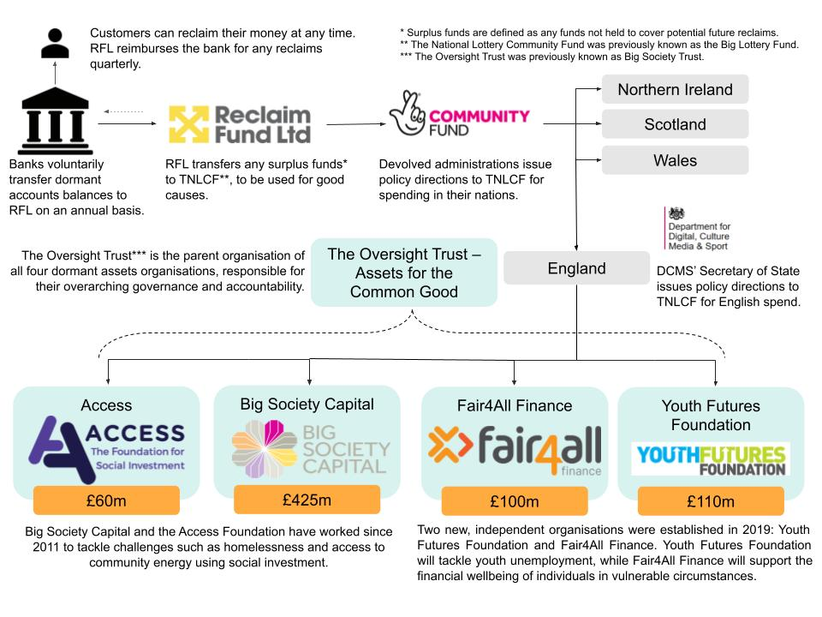
Where is the money spent?

Slide 10
Benefits to the sector, clients and communities
Value to investment & wealth managers
Harnessing the value of assets that cannot be reunited with their owners for social and community causes
Value to asset owners
Owners can be reunited with their assets at any time
Value to communities
Unlocks cash to benefit a wide range of social causes
Transparency and accountability in the use of funds
Additional to local/ central government spend
Funds are held securely, backed by the UK government by an FCA-regulated entity
Eliminate reclaim risks, with quarterly reimbursement from RFL
Dormant assets are removed from the balance sheet
Demonstrating how the company is doing right both by clients, and wider society
Ability to contribute to government spend consultation July – September 2022

Slide 11
When can investment & wealth managers join?
Enablement
Dormant Assets Act passed on 24th February.
Legislation
Handbook changes to enable participation.
FCA consultation*
DCMS consultation to seek views on the direction of future Scheme spend.
Spend consultation*
March
April
May
June
July
August
Sep
Preparation
RFL readiness
Planned date to accept transfers from new sectors
Early adoption
Initial transfers expected from first participants
TAA negotiation
Agreement of the sector and RFL on the terms of participation.
IA member support
Engagement with members and concluding the operational mechanics.
* Precise dates to be confirmed

Slide 12
Joining the Dormant Assets Scheme
RFL Contact
Documentation
Participant completes Information Form
Transfer & Agency Agreement
RFL sends completed TAA based on information provided
RFL sends completed TAA for signature
RFL will send:
RFL conducts due diligence
Copy of Dormant Assets Act 2022
Transfer and Agency Agreement (TAA)
Scheme Handbook
Participant and RFL sign TAA
Joining Completion
RFL forwards documentation for initial transfer of dormant assets into the Scheme.
RFL issues a user guide and registration form for Participant Portal.

